Slide 1
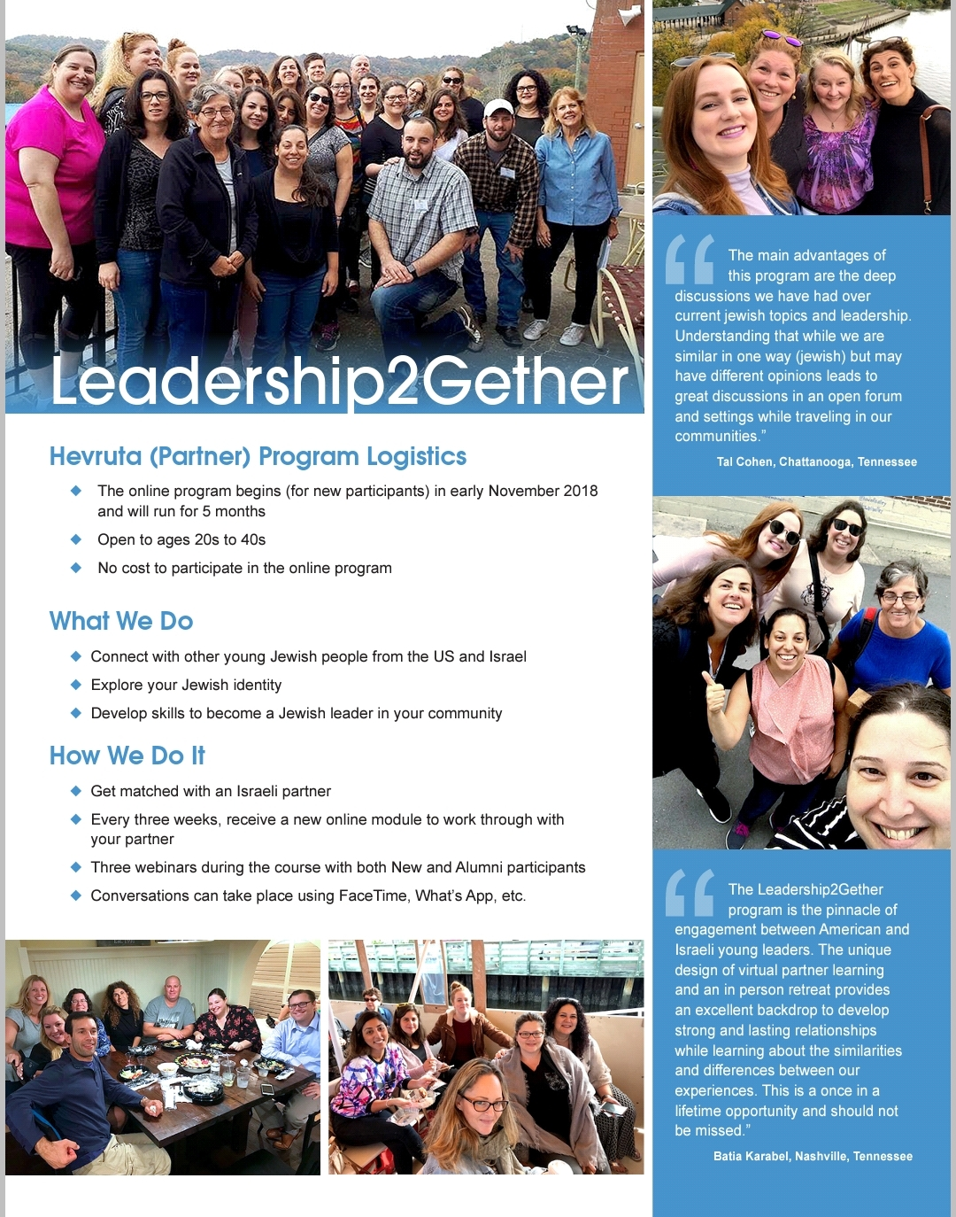

Slide 4
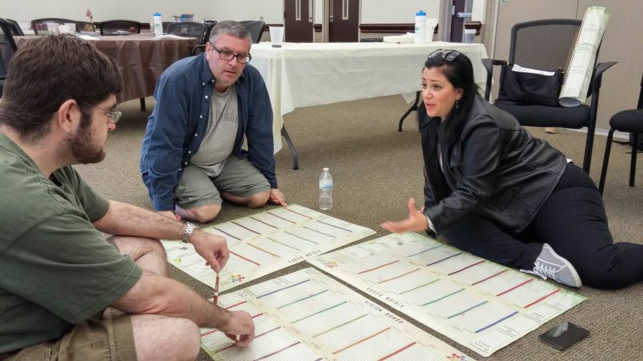
Living Bridge Adult Programs Committee
Recommendations:
Retreat was a highlight!!
Optimal group size is approx. 25 participants + staff.
Consider the goals of building leaders; how do we bring the participants into the planning process? What other ways do we foster peer leadership?
Consider to bring the American cohort together before the retreat either by geographic proximity or technology; webinars would support this as well.
Explore opportunity for the retreat in Israel
Successful program is one that have two components – course and Retreat but good experience was shown in participants who did only one part.

